Slide 1
ENSE 470 Milestone 1
Group Eh?
Nickolas Schmidt, Quinn Bast Abdulaziz Alghamdi
January 18th 2017

Slide 2
Team Introductions
Quinn Bast, Nickolas Schmidt, Abdulaziz Alghamd
Our team name is Team Eh?

Slide 3
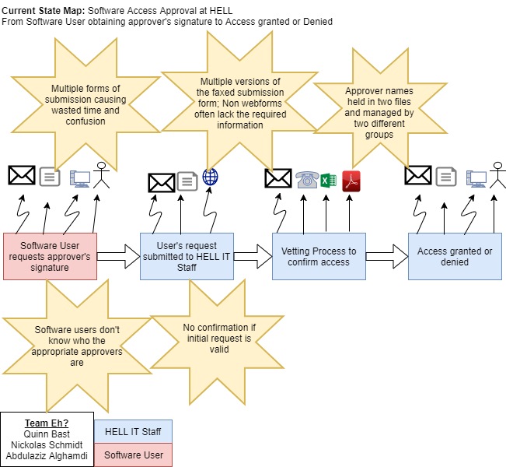
Current State Value Stream Map (VSM)

Slide 4
Group Reflection
How did you feel about this milestone? What did you like/dislike?
It was a nice introductory task that helped us meet our team members and work together to accomplish a task. It is a good first task and very good time-wise.
What did you learn about yourself as you collaborated and worked through this milestone?
We learned some of our team member’s different strengths and how to divide up the work equally amongst one another.
How will you use what you have learned going forward?
Our understanding of VSM diagrams will further our design knowledge in later milestones and the use of git will become extremely valuable when collaborating.
What "Stuff & Things" related to this milestone would you want help with?
This milestone was simplistic and easy to understand which made it very suitable for our first step in this project

